Slide 1
Chapter 10
Working with Databases

Slide 2
Topics
10.1 Database Management Systems
10.2 Database Concepts
10.3 DataGridView Control
10.4 Data-Bound Controls
10.5 Structured Query Language (SQL)
10.6 Focus on Problem Solving: Karate School Management Application
10.7 Introduction to LINQ
10.8 Creating Your Own Database

Slide 3
Introduction
In this chapter you will learn:
Basic database concepts
How to write Visual Basic applications that interact with databases
How to use a DataGridView control and display the data in a database
How to sort and update database data
To create an application that displays database data in list boxes, text boxes, labels, and combo boxes
To create your own database

Slide 4
Database Management Systems
10.1

Slide 5
Visual Basic and Database Management Systems
Simple text files as shown in chapter 9 are:
Fine for small amounts of data
But impractical for large amounts of data
Businesses must maintain huge amounts of data
A database management system (DBMS) is the typical solution to the data needs of business
Designed to store, retrieve, and manipulate data
Visual Basic can communicate with a DBMS
Tells DBMS what data to retrieve or manipulate

Slide 6
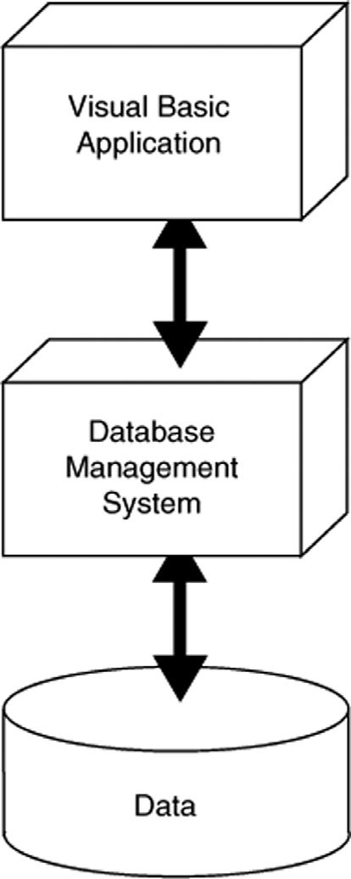
Layered Approach to Using a DBMS
Applications that work with a DBMS use a layered approach
VB application is topmost layer
VB sends instructions to next layer, the DBMS
DBMS works directly with data
Programmer need not understand the physical structure of the data
Just need to know how to interact with the database

Slide 7
Visual Basic Supports Many DBMS’s
Visual Basic can interact with many DBMS’s
Microsoft SQL Server
Oracle
DB2
MySQL
Microsoft SQL Server Express used in this chapter, which is installed with Visual Basic

Slide 8
Database Concepts
10.2

Slide 9
Terminology
A Database is a collection of interrelated tables
A Table is a logical grouping of related data
People, places, or things
For example, employees or departments
Organized into rows and columns
A Field is an individual piece of data pertaining to an item, an employee name for instance
A Record is the complete data about a single item such as all information about an employee
A record is a row of a table
A database schema is the design of tables, columns, and relationships between tables in a database

Slide 10
Database Table
Each table has a primary key or composite key
Uniquely identifies that row of the table
Emp_Id is the primary key in this example
Columns are also called fields or attributes
Each column has a particular data type
Emp_Id | First_Name | Last_Name | Department
001234 | Ignacio | Fleta | Accounting
002000 | Christian | Martin | Computer Support
002122 | Orville | Gibson | Human Resources
003400 | Ben | Smith | Accounting
003780 | Allison | Chong | Computer Support
Row
(Record)
Column
Field

Slide 11
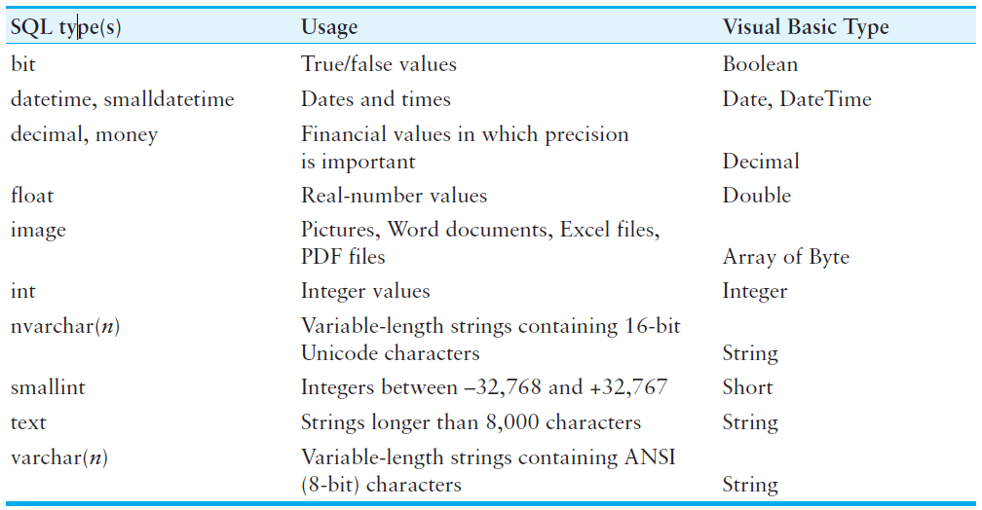
SQL Server Column Types

Slide 12
Choosing Column Names
Define a column for each piece of data
Allow plenty of space for text fields
Avoid using spaces in column names
For the members of an organization:
Column Name Type Remarks
Member_ID int Primary key
First_Name varchar(40)
Last_Name varchar(40)
Phone varchar(30)
Email varchar(50)
Date_Joined smalldatetime Date only, no time values
Meeings_Attended smallint
Officer Yes/No True/False values

Slide 13
Avoiding Redundancy by Using Linked Tables
Create a Departments table
Dept_ID Dept_Name Num_Employees
1 Human Resources 10
2 Accounting 5
3 Computer Support 30
4 Research & Development 15
Reference Departments table in Employees table
ID First_Name Last_Name Dept_ID
001234 Ignacio Fleta 2
002000 Christian Martin 3
002122 Orville Gibson 1
003000 Jose Ramirez 4
003400 Ben Smith 2
003780 Allison Chong 3

Slide 14
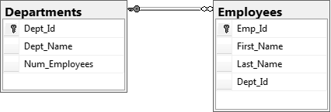
One-to-Many Relationship
Databases are designed around a relational model
A relation is a link or relationship that relies on a common field
The previous changes created a one-to-many relationship
Every employee has one and only one dept
Every department has many employees
DeptID in Departments table is a primary key
DeptID in Employees table is a foreign key
One-to-many relationship exists when primary key of one table is specified as a field of another table

Slide 15
DataGridView Control
10.3

Slide 16
Connecting to a Database
Visual Basic uses a technique called Data binding to link tables to controls on forms
Special controls called components establish the link
A software tool named a wizard guides you through the process
We will use these data-related components:
A Data source is usually a database
Can include text files, Excel spreadsheets, XML data, and Web services
A Binding source connects data bound controls to a dataset
A Table adapter pulls data from the database and passes it to your program
Uses Structured Query Language (SQL) is used to select data, add new rows, delete rows, and modify existing rows
A Dataset is an in-memory copy of data pulled from database tables

Slide 17
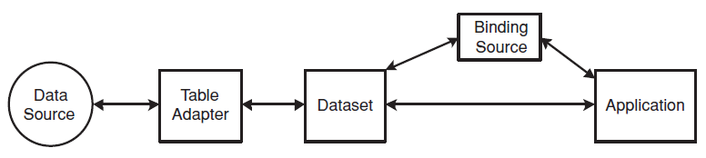
Connecting to a Database
The flow of data from database to application
Data travels from data source to application
Application can view/change dataset contents
Changes to dataset can be written back to the data source
Tutorial 10-1 demonstrates how to connect a database table to a DataGridView control
Tutorial 10-2 demonstrates updating and sorting a table

Slide 18
Data-Bound Controls
10.4

Slide 19
Advantages of Data-Bound Controls
Can bind fields in a data source to controls:
Text boxes
Labels
List boxes
Contents of data-bound controls change automatically when moving from row to row
Data-bound controls also allow the contents of a database field to be changed

Slide 20
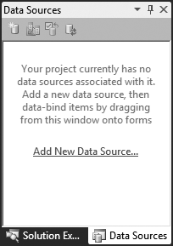
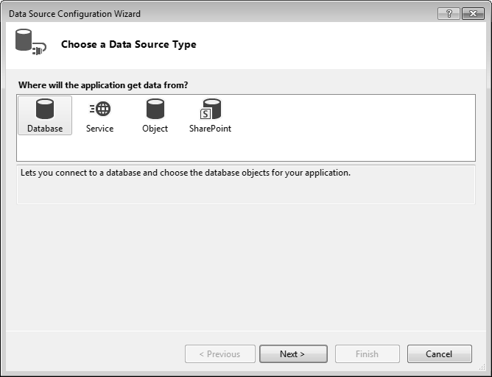
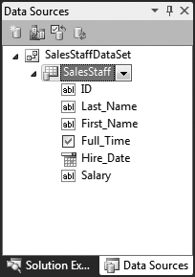
Adding a New Data Source
Open the Data Sources window and click the Add New Data Source link
Follow the steps in the Data Source Configuration Wizard to create a connection to the database

Slide 21
Deleting a Data Source
Once created, it’s almost impossible to rename a data source
Easier to delete and create a new data source than rename one
A data source named Employees for example would be defined by a file named Employees.xsd
To delete this data source:
Select Employees.xsd file in Solution Explorer window
Press Delete on the keyboard

Slide 22
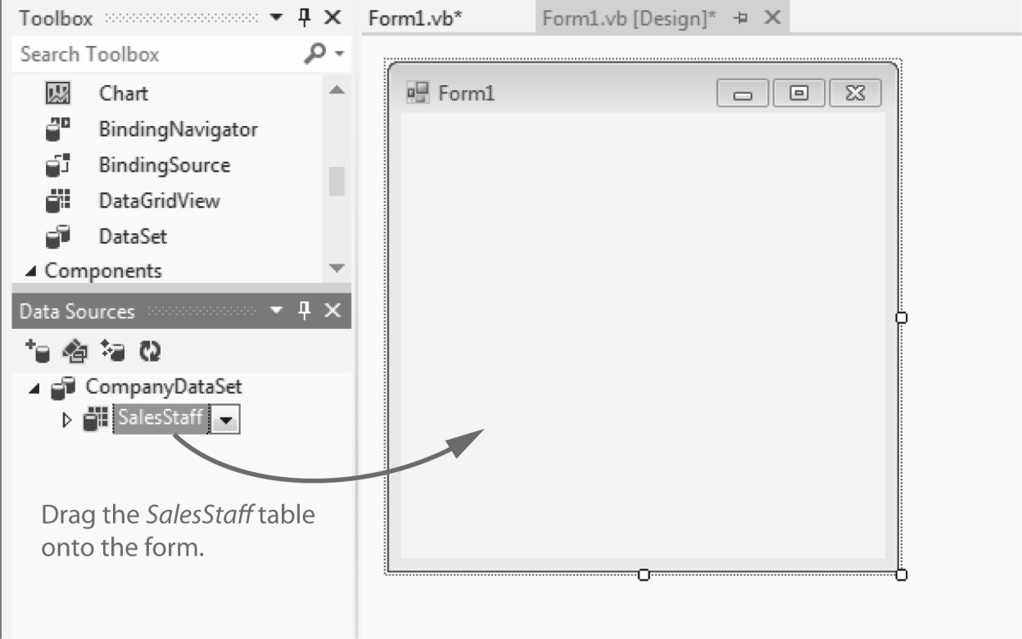
Binding the Data Source to a DataGridView Control
Drag and drop an existing dataset from the Data Sources window to an open area on the form
For example:

Slide 23
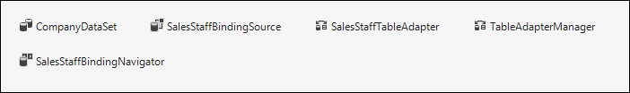
Binding the Data Source to a DataGridView Control
At the same time Visual Studio builds a DataGridView on the form, it adds a number of important objects to the form’s component tray:
The BindingNavigator creates a ToolStrip at the top of the form
The DataSet is an in-memory copy of the table
The BindingSource connects the DataGridView to the DataSet
The TableAdapter pulls data from the database into the DataSet
The AdapterManager is a tool for saving data in related tables

Slide 24
Binding Individual Fields to Controls
Use the dataset in the Data Sources window
Select Details from the table drop-down list
Drag table to an open area of a form
Creates a separate control for each field
Can also drag columns individually
Text and numeric fields added as text boxes
Yes/No fields added as checkboxes
DateTime fields use DateTimePicker controls
May wish to change some control properties
Tutorials 10-3 and 10-4 demonstrate binding

Slide 25
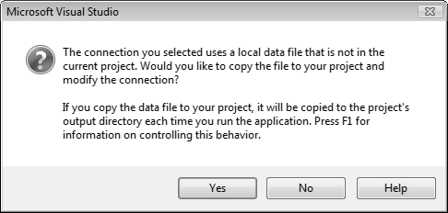
Copying the Database
When creating a new database connection, the following window appears:
Clicking the Yes button
Adds a copy of the existing database (.mdf) to the project folder
The existing database will not be modified
Clicking the No button
Will set up a connection string to the existing database
The existing database can be modified
Can cause problems if the project is moved to a different computer

Slide 26
Binding to ListBox and ComboBox Controls
List and combo boxes are frequently used to supply a list of items for a user to select from
Such lists are often populated from a table
Must set two list/combo box properties
The DataSource property identifies a table within a dataset
The DisplayMember property identifies the table column to be displayed in the list/combo box
If table column dragged onto a list/combo box
Visual Studio creates the required dataset, table adapter, and binding source components
Tutorial 10-5 demonstrates binding to a list box

Slide 27
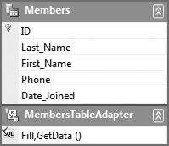
Adding Rows to a Database Table
A TableAdapter provides an easy way to add a row to a database table
To find the TableAdapter you must open a data set’s Schema Definition
A schema definition file (.xsd) was automatically created in Tutorial 10-5 for the Members table Dataset
Displays the names and data types of fields in the table
To edit the schema definition file:
Double-click its name in the Solution Explorer window
An editor window will open
A TableAdapter object was automatically created for the Members DataTable
Each DataTable has a TableAdapter associated with it

Slide 28
Adding Rows to a Database Table
A TableAdapter object has an Insert method
Used to add a new row to the database table
Each column is an argument of the method
Just provide the values for each argument
For example:
MembersTableAdapter.Insert(10, "Hasegawa", "Adrian",
"305-999-8888",#5/15/2010#)

Slide 29
Identity Columns
Some database tables have an identity column
Assigned a unique number by the database
Occurs automatically for identity columns
No need to manually supply a value for this column
Payments table uses an identity column
Omit ID column value
Only supply Member_Id, Payment_Date, and Amount
Tutorial 10-6 shows you how to insert new rows into the Payments table of the Karate database

Slide 30
Using Loops with DataTables
A For Each statement can be used to iterate over the rows collection of a table
Usually, it is best to create a strongly typed row that matches the type of rows in the table
For example:
Total the Amount column of PaymentsDataSet dataset
Tutorial 10-7 shows how to add a total to the Karate student payments application
Dim row As PaymentsDataSet.PaymentsRow
Dim decTotal As Decimal = 0
For Each row In Me.PaymentsDataSet.Payments.Rows
decTotal += row.Amount
Next

Slide 31
Structured Query Language (SQL)
10.5

Slide 32
Introduction
SQL stands for Structured Query Language
A standard language for working with database management systems
Standardized by the American National Standards Institute (ANSI)
The language of choice for interacting with database management systems
Consists of a limited set of keywords
Keywords construct statements called database queries
Queries are submitted to the DBMS
In response to queries, the DBMS carries out operations on its data

Slide 33
SELECT Statement
The SELECT statement retrieves data from a database
Used to select rows, columns, and tables
The most basic format for a single table is:
ColumnList must contain table column names separated by commas
The following statement selects the ID and Salary columns from the SalesStaff table:
SELECT ColumnList
FROM Table
SELECT ID, Salary
FROM SalesStaff

Slide 34
SQL Statements and Style
There is no required formatting or capitalization of SQL statements
The following queries are equivalent:
As a matter of style and readability
You should try to use consistent capitalization
SELECT ID, Salary FROM SalesStaff
select ID, Salary from SalesStaff
Select id, salary from salesstaff
SeLeCt Id, SaLaRy FrOm SaLeSsTaFf

Slide 35
SELECT Statement
Field names that contain embedded spaces must be surrounded by square brackets
For example:
The * character in the column list selects all the columns from a table
For example:
SELECT [Last Name], [First Name]
FROM Employees
SELECT *
FROM SalesStaff

Slide 36
Aliases for Column Names
Column names can be renamed using the AS keyword
The new column name is called an alias
For example:
Renaming columns is useful for two reasons:
You can hide the real column names from users for security purposes
You can rename database columns to make user friendly column headings in reports
SELECT Last_Name, Hire_Date AS Date_Hired
FROM SalesStaff

Slide 37
Creating Alias Columns from Other Columns
A query can create a new column from other existing columns
For example:
When strings occur in queries they must be surrounded by apostrophes
The + operator concatenates multiple strings into a single string
SELECT Last_Name + ', ' + First_Name AS Full_Name
FROM Members

Slide 38
Calculated Columns
You can create new columns from calculated column values
For example, the following query:
Multiplies the values of two columns
hoursWorked and hourlyRate
Displays the result as a new column (alias)
payAmount
SELECT employeeId, hoursWorked * hourlyRate AS payAmount
FROM PayRoll

Slide 39
Setting the Row Order with ORDER BY
SQL Select has an optional ORDER BY clause that affects the order in which rows appear
Displays rows in order by last name, then first
Sort in descending order (high to low) using DESC
ORDER BY clause appears after FROM clause
Lists all members by last name, then first
ORDER BY Last_Name, First_Name
ORDER BY Last_Name DESC
SELECT First_Name, Last_Name, Date_Joined
FROM Members
ORDER BY Last_Name, First_Name

Slide 40
Selecting Rows with the WHERE Clause
SQL Select has an optional WHERE clause that can be used to select (or filter) certain rows
Displays only rows where last name is Gomez
Must be a defined column (in table or created)
This example selects based on a created field
Selects those being paid more than $1,000
WHERE Last_Name = 'Gomez'
SELECT Last_Name, hrsWorked * Rate AS payAmount
FROM Payroll
WHERE payAmount > 1000
ORDER BY Last_Name

Slide 41
Relational Operators
SQL WHERE clause uses relational operators like an If statement
Operator Meaning
= equal to
<> not equal to
< less than
<= less than or equal to
> greater than
>= greater than or equal to
BETWEEN between two values (inclusive)
LIKE similar to (match using wildcard)
Example of BETWEEN operator:
Example of LIKE operator with % sign as wildcard:
WHERE (Hire_Date BETWEEN '1/1/2010' AND '12/31/2010')
WHERE Last_Name LIKE 'A%'

Slide 42
Compound Expressions
SQL uses AND, OR, and NOT to create compound expressions
Select all employees hired after 1/1/2010 and with a salary is greater than $40,000
Select all employees hired after 1/1/2010 or with a salary is greater than $40,000
Select employee names not beginning with A
WHERE (Hire_Date > '1/1/2010') AND (Salary > 40000)
WHERE (Hire_Date > '1/1/2010') OR (Salary > 40000)
WHERE Last_Name NOT Like 'A%'

Slide 43
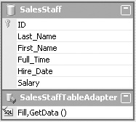
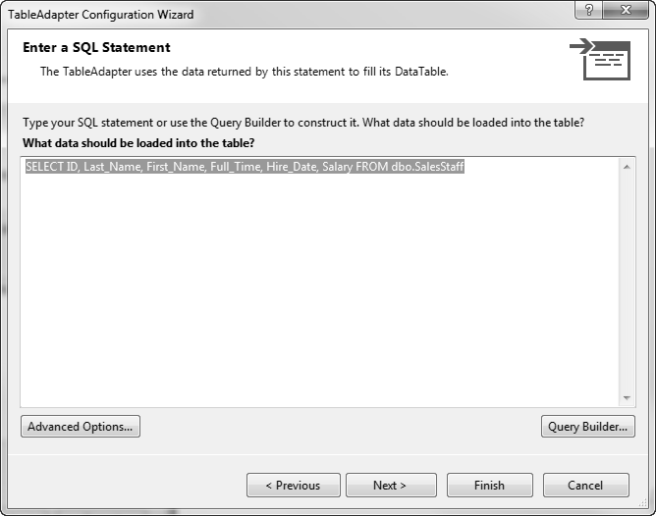
Modifying the Query in a Data Source
Dataset schema file contains an SQL query
Created as part of schema file
Named Fill, GetData() by default
Right-click title bar of TableAdapter in schema
Click Configure from pop-up
Use Configuration Wizard to change simple queries
Query Builder often used for complex queries

Slide 44
Query Builder
Visual Studio tool to work with SQL queries
Consists of four sections called panes
The Diagram pane displays tables
The Grid pane (Criteria pane)displays query in spreadsheet form
The SQL pane shows actual SQL created
The Results pane shows data returned by query

Slide 45
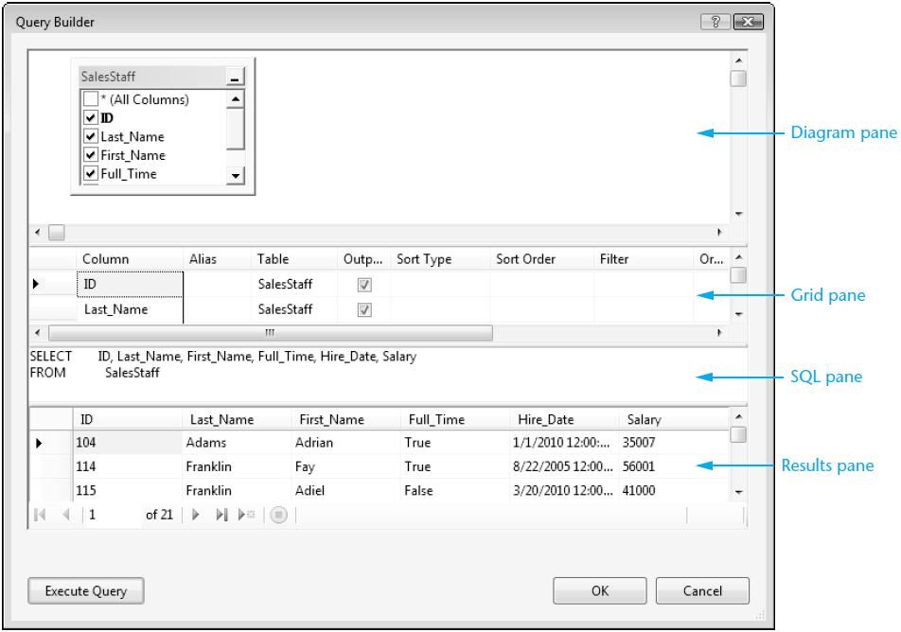
Example Query Builder Window

Slide 46
Adding a Query to a TableAdapter
Can add a new query as well as changing an existing one
Right-click the TableAdapter icon in component tray
Select Add Query
The Search Criteria Builder window appears
Add WHERE clause to the SELECT statement
Select the New query name to enter a name for query
Query made available from ToolStrip control
Tutorial 10-8 shows how to filter rows in the SalesStaff table

Slide 47
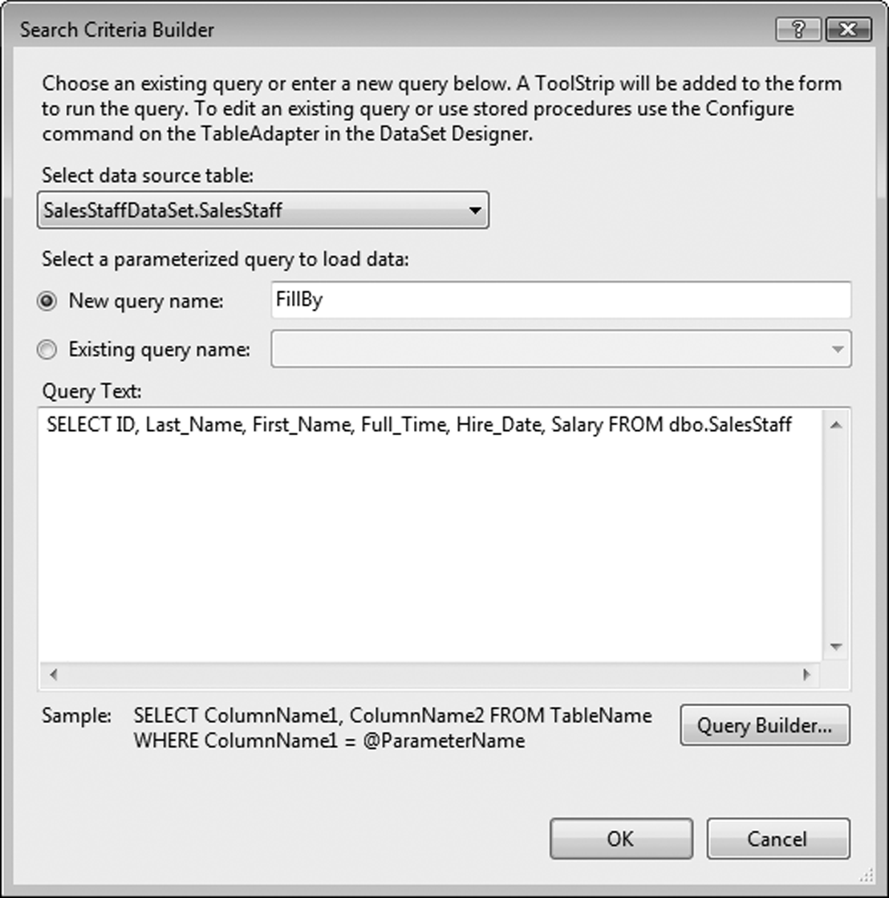
Example Search Criteria Builder Window

Slide 48
Focus on Problem Solving: Karate School Management Application
10.6

Slide 49
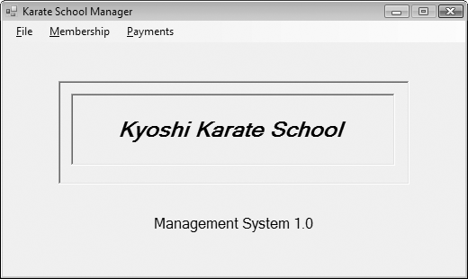
Karate School Manager Startup Form
Menu Selections:
File
Exit
Membership
List All
Find member
Add new member
Payments
All members
One member

Slide 50
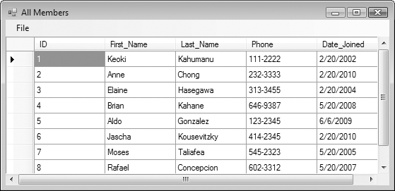
All Members Form

Slide 51
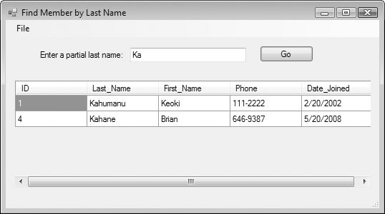
Find Member by Last Name Form

Slide 52
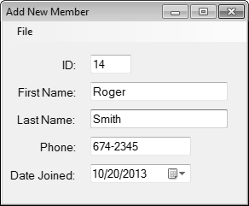
Add New Member Form

Slide 53
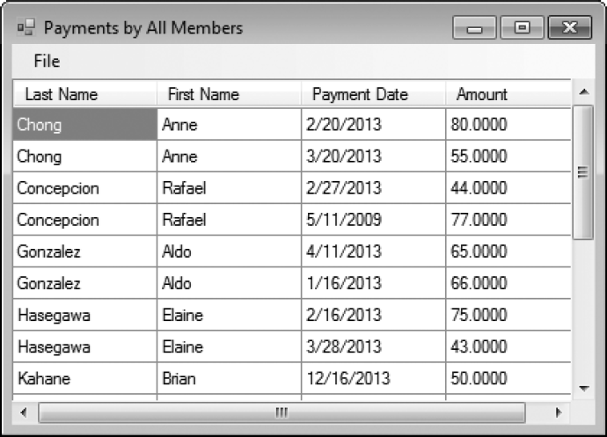
Payment Form

Slide 54
Introduction to LINQ
10.7

Slide 55
LINQ
SQL allows you to query the data in a database.
LINQ allows you to query data from many other sources.
LINQ is built into Visual Basic.

Slide 56
Using LINQ to Query an Array
Suppose we have the following array:
The following statement uses LINQ to query the array for all values greater than 100:
Dim intNumbers() As Integer = {4, 104, 2, 102, 1, 101, 3, 103}
From item In intNumbers
Where item > 100
Select item

Slide 57
Using LINQ to Add Query Results to a ListBox
We can add the results to a ListBox
' Create an array of integers.
Dim intNumbers() As Integer = {4, 104, 2, 102, 1, 101, 3, 103}
' Use LINQ to query the array for all numbers
' that are greater than 100.
Dim queryResults = From item In intNumbers
Where item > 100
Select item
' Add the query results to the list box.
For Each intNum As Integer In queryResults
lstResults.Items.Add(intNum)
Next

Slide 58
Sorting the Results of a LINQ Query
Sort in ascending order:
Sort in descending order:
Dim queryResults = From item In intNumbers
Where item > 100
Select item
Order By item
Dim queryResults = From item In intNumbers
Where item > 100
Select item
Order By item Descending

Slide 59
More About LINQ
LINQ uses operators that are similar to SQL
Unlike SQL, LINQ is built into Visual Basic
Queries are written directly into the program
VB compiler checks the syntax of the query
Immediately displays LINQ mistakes
LINQ can be used to query any data that is stored in memory as an object
An application named LINQ can be found in the Chap10 student sample programs folder

Slide 60
Creating Your Own Database
10.8

Slide 61
Advantages to Creating Your Own Database
There are many advantages to being able to create your own database
Keep track of your collections
Build schedules for activities
Keep track of customers for a new business

Slide 62
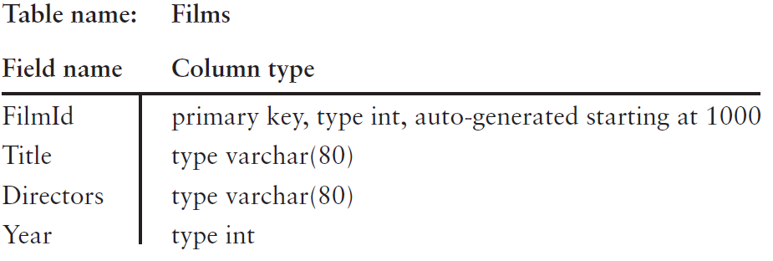
Designing Your Database
It is a good idea to make a quick and easy design of the table structures for the database
Tutorial 10-14 demonstrates how to create a database that keeps track of information about commercial films

